Slide 1
Database Systems
Hanem A. Eladly
Computer Engineering Department
Faculty of Engineering
Cairo University
hanemeladly@yahoo.com “temp email”
Group Representative:
Semester: ?
CHS: Hisham Hassan Mostafa
hisham_mano@hotmail.com

Slide 2
Readings
TEXTBOOK
[1] Ramez Elmasri and Shamkant B. Navathe, Fundamentals of Database Systems, 5th Edition, 2007, Addison-Wesley, ISBN 0-321-36957-2.
REFERENCES
[1] C. J. Date, An Introduction to Database Systems, 8th Edition, 2003, Addison-Wesley, ISBN 0-321-19784-4.
[2] Thomas Connolly and Carolyn Begg, Database Systems, 4th Edition, 2005, Pearson Education, ISBN 0-273-70413-3.

Slide 3
Grading
Semester
Final 90/150
Midterm 25/150
Term Project 25/150
Assignments/Labs 10/150
Credit Hour System
Final 40/100
Midterm 20/100
Term Project 20/100
Assignments/Labs 15/100
Attendance 5/100

Slide 4
Topics We Will Cover
Basic Concepts
Data Modeling
Relational Algebra
Relational Data Model
Relational Database Design
Functional Dependency and Normalization
SQL-99 and Database Programming

Slide 5
1) Introduction: Databases and Database Users
This material is a modified version of the slides provided by Ramez Elmasri and Shamkant Navathe for their book “Fundamentals of Database Systems”, 5th edition.

Slide 6
Outline
Database Definition
Types of Databases and Database Applications
Basic Definitions
Typical DBMS Functionality
Example of a Database (UNIVERSITY)
Main Characteristics of the Database Approach
Database Users
Advantages of Using the Database Approach
When Not to Use Databases

Slide 7

Introduction
What is a database?
  Collection of related data.
What is data?
  Known facts that can be recorded and have an implicit meaning.

Slide 8
Database Definition
“A database has some source from which data are derived, some degree of interaction with events in the real world, and an audience that is actively interested in the contents of the database”
Implicit Properties of a Database:
  Represents some aspect of the real world (Mini-world).
  A logically coherent collection of words with some inherent meaning.
  Designed, built & populated with data for a specific purpose.
Notes:
The common use of the term database is normally quite restricted.
Changes in this aspect shall be reflected in the database.
A random assortment of data cannot correctly be referred to as a database.
It has an intended group of users and some preconceived applications in which these users are interested.

Slide 9
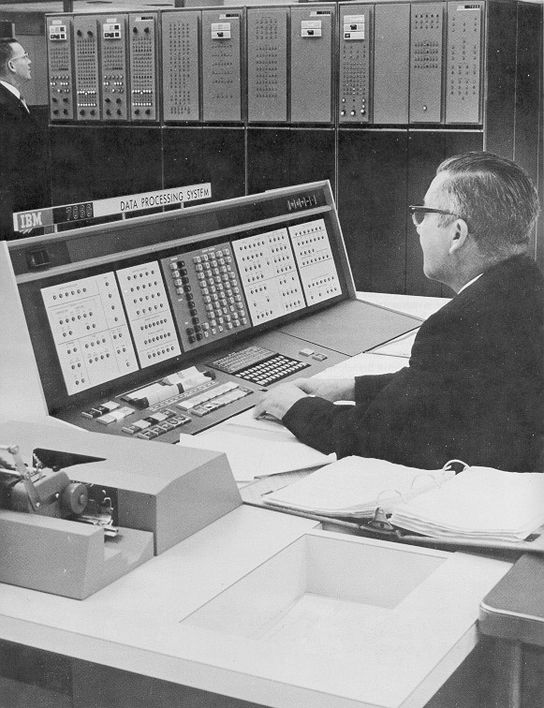
Database Systems: Then

Slide 10

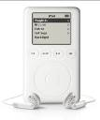









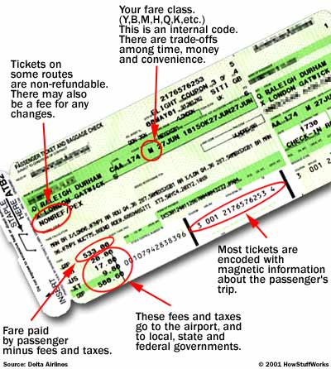

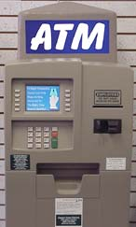
Databases Everywhere

Slide 11
Types of Databases and Database Applications
Traditional Applications:
  Numeric and Textual Databases
More Recent Applications:
  Multimedia Databases
  Geographic Information Systems (GIS)
  Data Warehouses
  Real-time and Active Databases
  Many other applications
First part of book focuses on traditional applications
A number of recent applications are described later in the book (for example, Chapters 24,26,28,29,30)

Slide 12
Database Implementation
Defining a database
  Data types
  Structures
  Constraints
Constructing a database
  Storing the data itself on a storage medium
Manipulating a database
  Querying
  Updating
  Generating reports

Slide 13
Database Management System (DBMS)
General-purpose software system that facilitates the processes of defining, constructing and manipulating databases.
Can also write your own set of programs to create and maintain the database, i.e. your own Special-purpose DBMS software.
Database + Software == Database System
Notes:
Both types of software implement a computerized database.
Note that in both cases, we usually have to employ a considerable amount of software to manipulate the database in addition to the database itself.

Slide 14
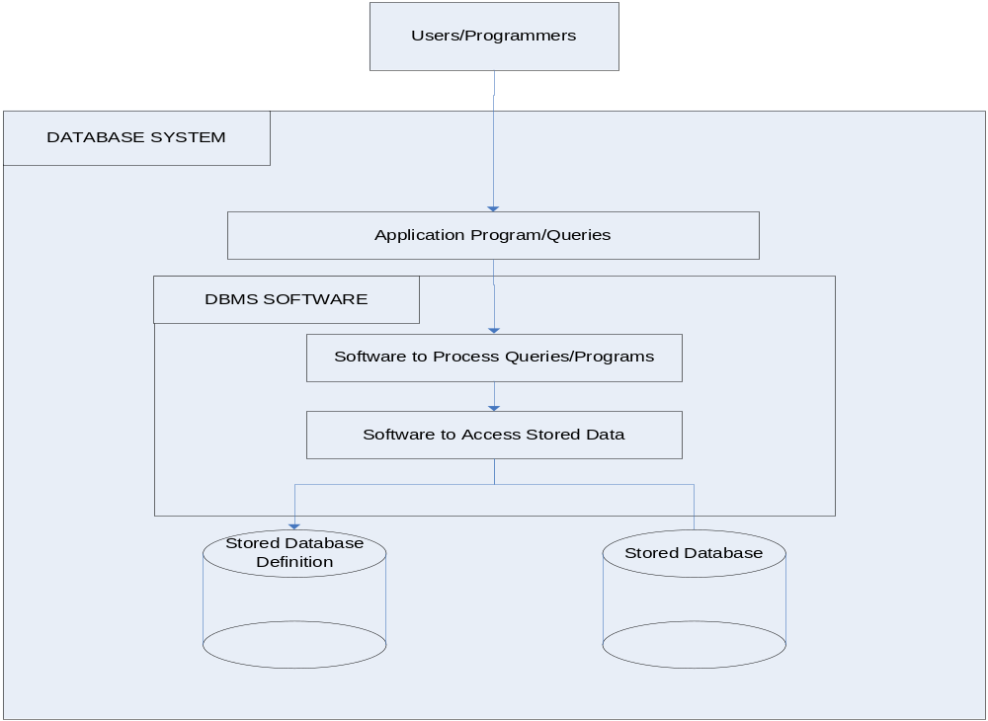

Slide 15
3. Users
2. Software
1. Data
4. Hardware

Slide 16
Summary of Basic Definitions
Database:
  A collection of related data.
Data:
  Known facts that can be recorded and have an implicit meaning.
Mini-world:
  Some part of the real world about which data is stored in a database. For example, student grades and transcripts at a university.
Database Management System (DBMS):
  A software package/ system to facilitate the creation and maintenance of a computerized database.
Database System:
  The DBMS software together with the data itself. Sometimes, the applications are also included.

Slide 17
Typical DBMS Functionality
Define a particular database in terms of its data types, structures, and constraints
Construct or Load the initial database contents on a secondary storage medium
Manipulating the database:
  Retrieval: Querying, generating reports
  Modification: Insertions, deletions and updates to its content
  Accessing the database through Web applications
Processing and Sharing by a set of concurrent users and application programs – yet, keeping all data valid and consistent

Slide 18
Typical DBMS Functionality
Other features:
  Protection or Security measures to prevent unauthorized access
  “Active” processing to take internal actions on data
  Presentation and Visualization of data
  Maintaining the database and associated programs over the lifetime of the database application
    Called database, software, and system maintenance

Slide 19
Example of a Database
(with a Conceptual Data Model)
Mini-world for the example:
  Part of a UNIVERSITY environment.
Some mini-world entities:
  STUDENTs
  COURSEs
  SECTIONs (of COURSEs)
  (academic) DEPARTMENTs
  INSTRUCTORs

Slide 20
Example of a Database
(with a Conceptual Data Model)
Some mini-world relationships:
  SECTIONs are of specific COURSEs
  STUDENTs take SECTIONs
  COURSEs have prerequisite COURSEs
  INSTRUCTORs teach SECTIONs
  COURSEs are offered by DEPARTMENTs
  STUDENTs major in DEPARTMENTs
Note: The above entities and relationships are typically expressed in a conceptual data model, such as the ENTITY-RELATIONSHIP data model (see Chapters 3, 4)

Slide 21

Example of a simple database
STUDENT
Name | Student_number | Class | Major
Smith | 17 | 1 | CS
Brown | 8 | 2 | CS

Slide 22
The Database Approach Vs File Processing Approach
In traditional file processing, each user defines and implements the files needed for a specific application.
  redundancy in defining and storing data.
  wastes storage space and effort used to maintain the common data up-to-date.
In the database approach, a single repository of data is maintained that is defined once and then is accessed by various users.
Notes:
A number of characteristics distinguish the database approach from the traditional approach of programming with files. In traditional file processing, each user defines and implements the files needed for a specific application which leads to redundancy in defining and storing data. This wastes storage space and effort used to maintain the common data up-to-date.
In the database approach, a single repository of data is maintained that is defined once and then is accessed by various users.

Slide 23
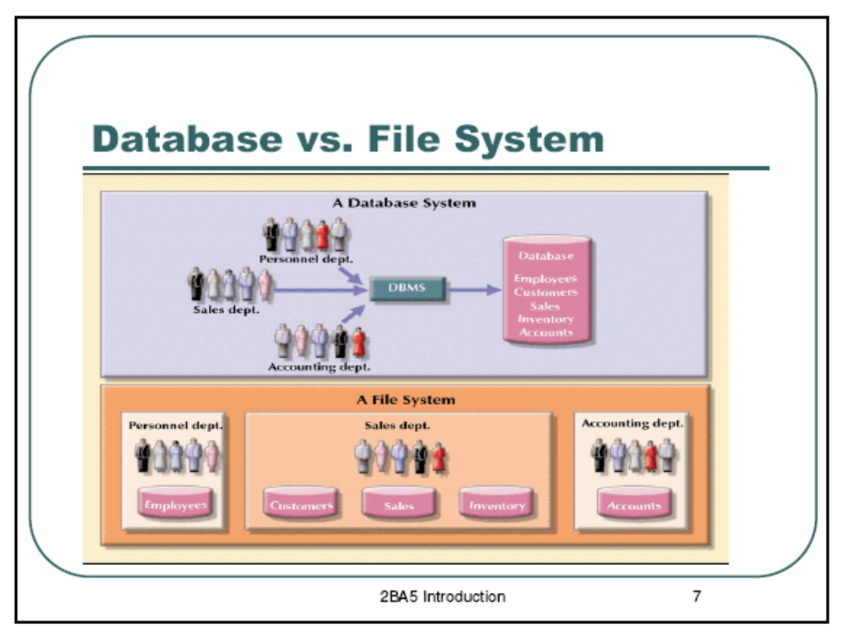

Slide 24
Meta-data/ Schema

Slide 25

Example of a simplified database catalog

Slide 26
Main Characteristics of the Database Approach
Self-describing nature of a database system:
  A DBMS catalog stores the description of a particular database (e.g. data structures, types, and constraints)
  The description is called meta-data.
  This allows the DBMS software to work with different database applications.
Insulation between programs and data:
  Called program-data independence.
  Allows changing data structures and storage organization without having to change the DBMS access programs.

Slide 27
Main Characteristics of the Database Approach (continued)
Data Abstraction:
  A data model is used to hide storage details and present the users with a conceptual view of the database.
  Programs refer to the data model constructs rather than data storage details
Support of multiple views of the data:
  Each user may see a different view of the database, which describes only the data of interest to that user.

Slide 28
Main Characteristics of the Database Approach (continued)
Sharing of data and multi-user transaction processing:
  Allowing a set of concurrent users to retrieve from and to update the database.
  Concurrency control within the DBMS guarantees that each transaction is correctly executed or aborted
  Recovery subsystem ensures each completed transaction has its effect permanently recorded in the database
  OLTP (Online Transaction Processing) is a major part of database applications. This allows hundreds of concurrent transactions to execute per second.

Slide 29
Database Users
Users may be divided into
  Actors on the Scene: Those who actually use and control the database content, and those who design, develop and maintain database applications
  Workers Behind the Scene: Those who design and develop the DBMS software and related tools, and the computer systems operators

Slide 30
Database Users
Actors on the scene
  Database administrators:
    Responsible for authorizing access to the database, for coordinating and monitoring its use, acquiring software and hardware resources, controlling its use and monitoring efficiency of operations.
  Database Designers:
    Responsible to define the content, the structure, the constraints, and functions or transactions against the database. They must communicate with the end-users and understand their needs.

Slide 31
Categories of End-users
Actors on the scene (continued)
  End-users: They use the data for queries, reports and some of them update the database content. End-users can be categorized into:
    Casual: access database occasionally when needed
    Naïve or Parametric: they make up a large section of the end-user population.
      They use previously well-defined functions in the form of “canned transactions” against the database.
      Examples are bank-tellers or reservation clerks who do this activity for an entire shift of operations.

Slide 32
Categories of End-users (continued)
    Sophisticated:
      These include business analysts, scientists, engineers, others thoroughly familiar with the system capabilities.
      Many use tools in the form of software packages that work closely with the stored database.
    Stand-alone:
      Mostly maintain personal databases using ready-to-use packaged applications.
      An example is a tax program user that creates its own internal database.
      Another example is a user that maintains an address book

Slide 33
Advantages of Using the Database Approach
Controlling redundancy in data storage and in development and maintenance efforts.
  Sharing of data among multiple users.
Restricting unauthorized access to data.
Providing persistent storage for program Objects
  In Object-oriented DBMSs – see Chapters 20-22
Providing Storage Structures (e.g. indexes) for efficient Query Processing

Slide 34
Advantages of Using the Database Approach (continued)
Providing backup and recovery services.
Providing multiple interfaces to different classes of users.
Representing complex relationships among data.
Enforcing integrity constraints on the database.
Drawing inferences and actions from the stored data using deductive and active rules

Slide 35
Additional Implications of Using the Database Approach
Potential for enforcing standards:
  This is very crucial for the success of database applications in large organizations. Standards refer to data item names, display formats, screens, report structures, meta-data (description of data), Web page layouts, etc.
Reduced application development time:
  Incremental time to add each new application is reduced.

Slide 36
Additional Implications of Using the Database Approach (continued)
Flexibility to change data structures:
  Database structure may evolve as new requirements are defined.
Availability of current information:
  Extremely important for on-line transaction systems such as airline, hotel, car reservations.
Economies of scale:
  Wasteful overlap of resources and personnel can be avoided by consolidating data and applications across departments.

Slide 37
Historical Development of Database Technology
Early Database Applications:
  The Hierarchical and Network Models were introduced in mid 1960s and dominated during the seventies.
  A bulk of the worldwide database processing still occurs using these models, particularly, the hierarchical model.
Relational Model based Systems:
  Relational model was originally introduced in 1970, was heavily researched and experimented within IBM Research and several universities.
  Relational DBMS Products emerged in the early 1980s.

Slide 38
Historical Development of Database Technology (continued)
Object-oriented and emerging applications:
  Object-Oriented Database Management Systems (OODBMSs) were introduced in late 1980s and early 1990s to cater to the need of complex data processing in CAD and other applications.
    Their use has not taken off much.
  Many relational DBMSs have incorporated object database concepts, leading to a new category called object-relational DBMSs (ORDBMSs)
  Extended relational systems add further capabilities (e.g. for multimedia data, XML, and other data types)

Slide 39
Historical Development of Database Technology (continued)
Data on the Web and E-commerce Applications:
  Web contains data in HTML (Hypertext markup language) with links among pages.
  This has given rise to a new set of applications and E-commerce is using new standards like XML (eXtended Markup Language). (see Ch. 27).
  Script programming languages such as PHP and JavaScript allow generation of dynamic Web pages that are partially generated from a database (see Ch. 26).
    Also allow database updates through Web pages

Slide 40
Extending Database Capabilities
New functionality is being added to DBMSs in the following areas:
  Scientific Applications
  XML (eXtensible Markup Language)
  Image Storage and Management
  Audio and Video Data Management
  Data Warehousing and Data Mining
  Spatial Data Management
  Time Series and Historical Data Management
The above gives rise to new research and development in incorporating new data types, complex data structures, new operations and storage and indexing schemes in database systems.

Slide 41
When not to use a DBMS
Main inhibitors (costs) of using a DBMS:
  High initial investment and possible need for additional hardware.
  Overhead for providing generality, security, concurrency control, recovery, and integrity functions.
When a DBMS may be unnecessary:
  If the database and applications are simple, well defined, and not expected to change.
  If there are stringent real-time requirements that may not be met because of DBMS overhead.
  If access to data by multiple users is not required.

Slide 42
When not to use a DBMS
When no DBMS may suffice:
  If the database system is not able to handle the complexity of data because of modeling limitations
  If the database users need special operations not supported by the DBMS.

Slide 43
Summary
Types of Databases and Database Applications
Basic Definitions
Typical DBMS Functionality
Example of a Database (UNIVERSITY)
Main Characteristics of the Database Approach
Database Users
Advantages of Using the Database Approach
When Not to Use Databases

